Slide 1
TEXT SUMMARIZER
A NLP based Web Application

Slide 2
What is Text Summarizer
Text Summarizer is a machine learning and web application project designed to convert a text into a summary. Text summarization is the problem of creating a short, accurate, and fluent summary of a longer text document.
Automatic text summarization methods are greatly needed to address the ever-growing amount of text data available online to both better help discover relevant information and to consume relevant information faster.

Slide 3
Text Summarization techniques:
Extractive Summarization:
It means identifying important sections of the text and generating them precisely producing a subset of the sentences from the original text.
Abstractive Summarization:
It reproduces important material in a new way after interpretation and examination of the text using advanced natural language techniques to generate a new shorter text that conveys the most critical information from the original one.
Hybrid Summarization:
Combination of Extractive and Abstractive text summarization technique.

Slide 4
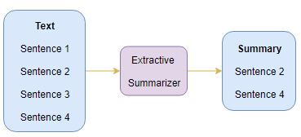

Slide 5
Text Rank Algorithm
TextRank is an extractive and unsupervised text summarization technique. For the task of automated summarization,Textrank models any document as a graph using sentences as a nodes. A function to compute the similarity of sentences is needed to build edges in between. This function is used to weight the graph edges,the higher the similarity between sentences the more important the edge between them will be in the graph.TextRank determines the relation of similarity between two sentences based on the context that both share.This overlap is calculated simply as the number of common lexical tokens between them,divided by the length of each to avoid promoting the long sentences.
The libraries for text summarization are NLTK, Sumy, Gensim, Spacy which is based on Text Rank algorithm.

Slide 6
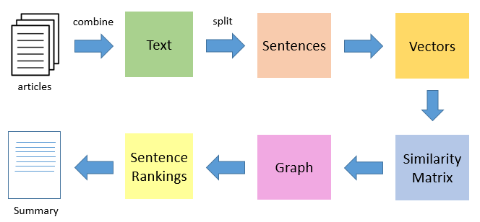
Flow Diagram

Slide 7
Similarity Matrix
Suppose we have four words in any paragraph w1,w2,w3 and w4. And we have created a table for finding the relation between them according to their occurrence in the paragraph. To provide the phrase ranking, we need to give them ratings of measure according to their occurrence. This rating would tell us the probability of occurrence of words together. To measure the probabilities, we would require a square matrix of m⤬m size where m = no. of words.

Slide 8
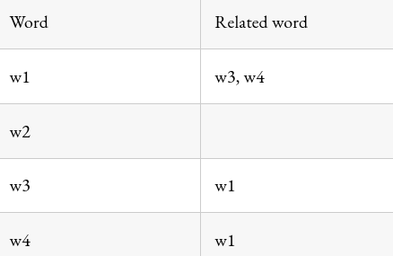
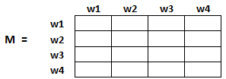
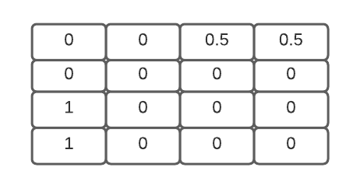

Slide 9
Libraries
Following are the libraries that have been used for text summarization :-
spaCy:-
spaCy is a free, open-source advanced natural language processing library, provides a fast and accurate syntactic analysis, named entity recognition and ready access to word vectors.spaCy also offers tokenization, sentence boundary detection, POS tagging, syntactic parsing, integrated word vectors, and alignment into the original string with high accuracy.
Sumy
We are using a lexrank technique for text summarization.Lexrank is an unsupervised approach to text summarization based on graph-based centrality scoring of sentences.

Slide 10
3. nltk
Natural language processing (NLP) is a field that focuses on making natural human language usable by computer programs.Libraries used in project are:-
Nltk.tokenize
nltk.corpus
4. Gensim
Gensim = “Generate Similar” is a popular open source natural language processing (NLP) library used for unsupervised topic modeling.Gensim, implemented in Python and Cython, is designed to handle large text collections using data streaming as well as incremental online algorithms. This makes it different from those machine learning software packages that target only in-memory processing.

Slide 11
Summarization using URL
Enter a URL
Extract the text by using Beautiful Soup through that URL
Beautiful Soup:
- It uses HTML tags to extract data from web pages
- Here, we are using <p> (paragraph tags) to extract
text from the webpage

Slide 12
Compare Summarizers
Compare summarizer is an another page linked to our website.
User can access this page by clicking the “Compare Summarizer” nav-link present in the navbar.
After reaching the page, the user will find the input text and the summary associated with the respective text obtained from a particular algorithm that has been selected.
The user can also obtain different summaries of the input text by clicking on the different algorithms.
He can also compare the minimum reading time which will be displayed along with the summary.
Then he can choose the best choice according to his requirement.

Slide 13
Integration
For the integration purpose we are using flask. Flask is a python based micro-framework used for small scale website. We are designing a web application where the user can throw the input in the form of plain text or the URL of a website from which he wants to obtain the summary.
In flask we create functions according to the number of pages of the web application. Each page has a function associated to it. Since our web application contains two pages, two functions of flask will be declared along with various other functions.

Slide 14
Deployment
We are deploying our flask based web app on Heroku platform.
Heroku is a platform as a service(PaaS).Heroku makes building and deploying applications really friendly for developers.It removes much of the burden related to building and running web applications,taking care of most infrastructure details and letting you focus on creating and improving the app.All heroku-based applications are hosted by Amazon Web Service(AWS).

Slide 15
Web link to our project
https://text-summaryzer-app.herokuapp.com/

Slide 16
Thank you
Made by:
Krati Tiwari (18223)
Muskan Gupta (18228)
Suchita Yadav (18252)

